Slide 1
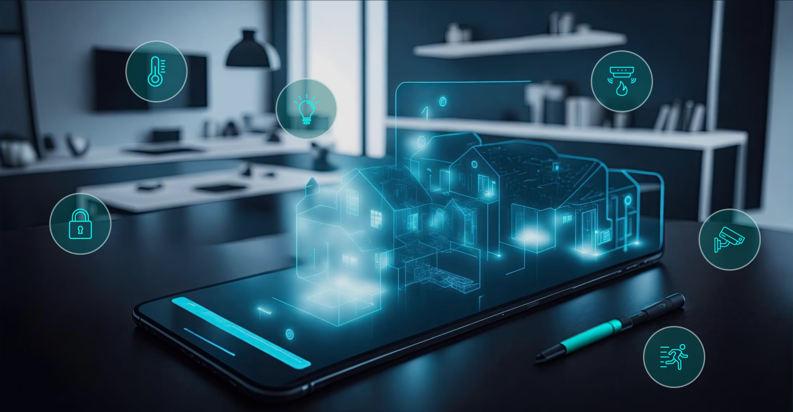

Team 61: Smart Home Automation
Bi-Weekly Update 4 Nick Tool, Tyler Mayou, Matthew McLean Sponsor: Souryendu Das TA: Fahrettin Ay
Notes:
Michelle

Slide 2
Project Summary
The Problem: “Smart home systems are often composed of many different components from different companies. This can make it very difficult for a user to combine devices and implement a fully functional system for their own personal living or working space.”
Our Goal: “Develop a basic smart home automation system that allows users to control a few essential home appliances (like lights and speakers) via a mobile app and a simple web interface. The system will use IoT/non-IoT devices and a local server and online database.”
Notes:
Kyle

Slide 3
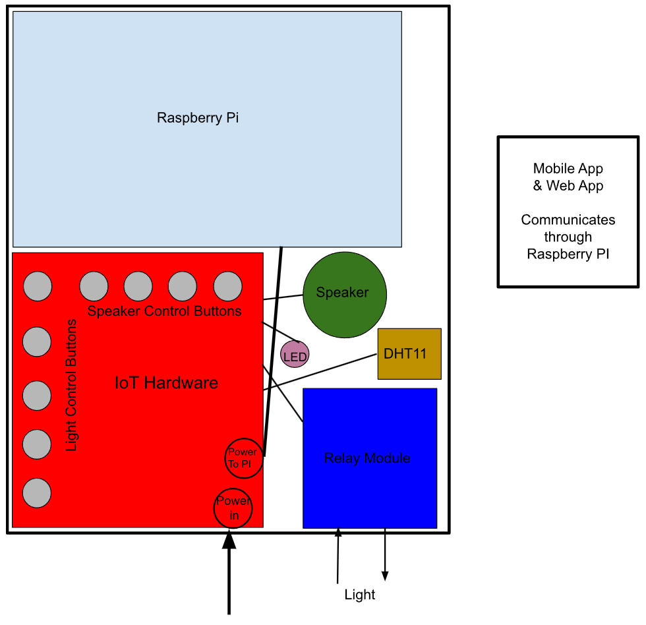
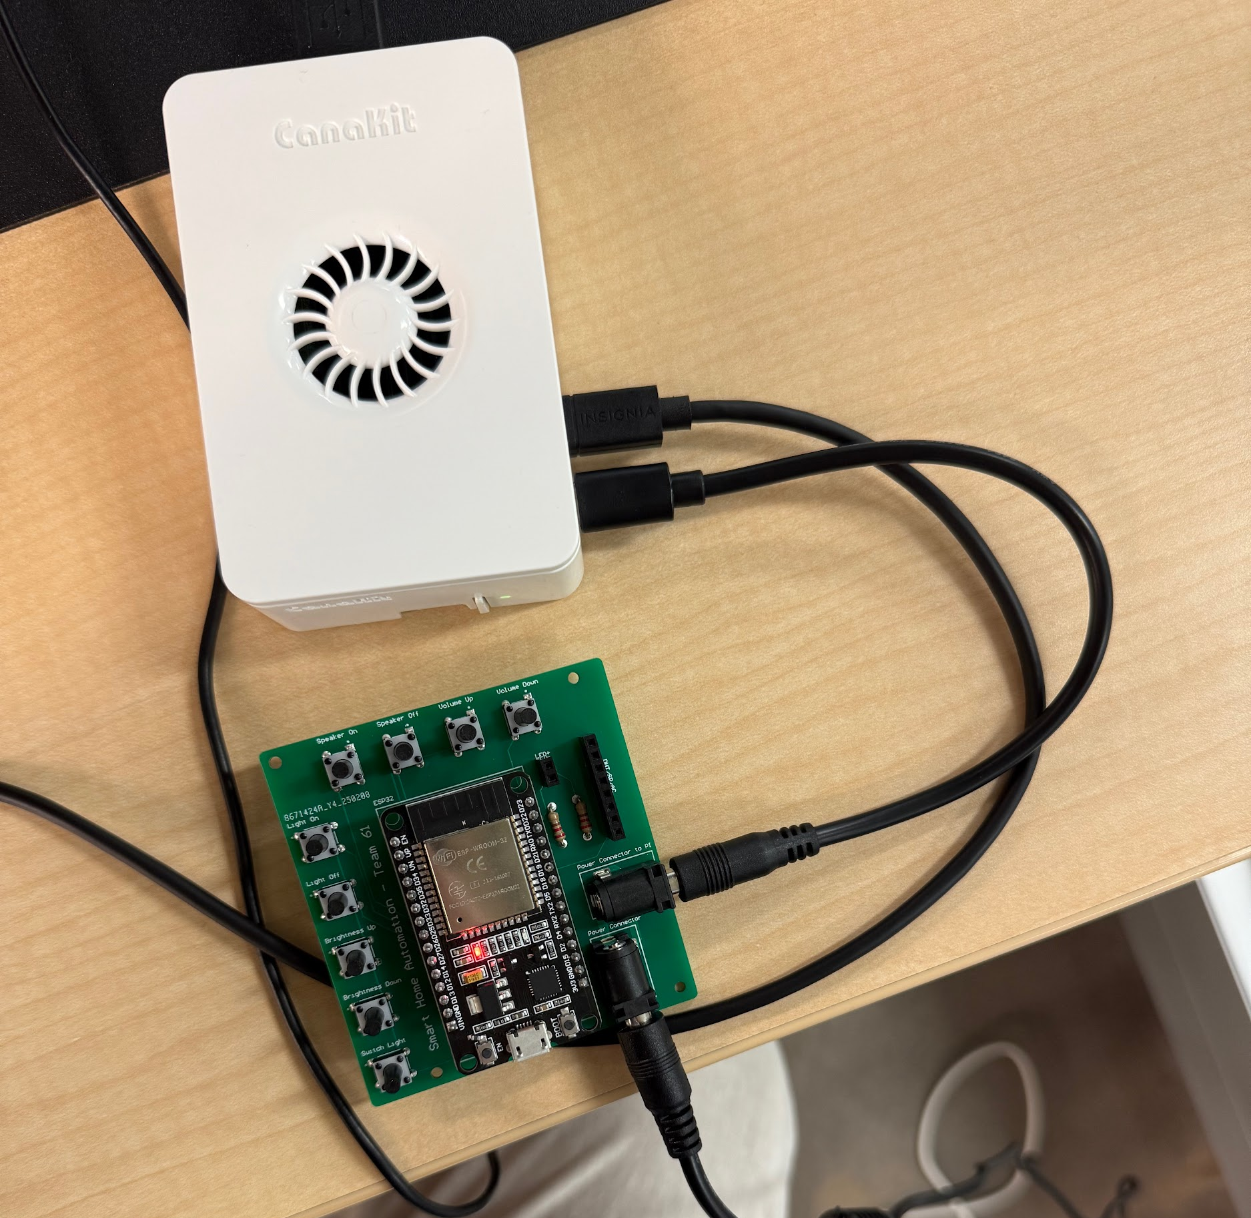
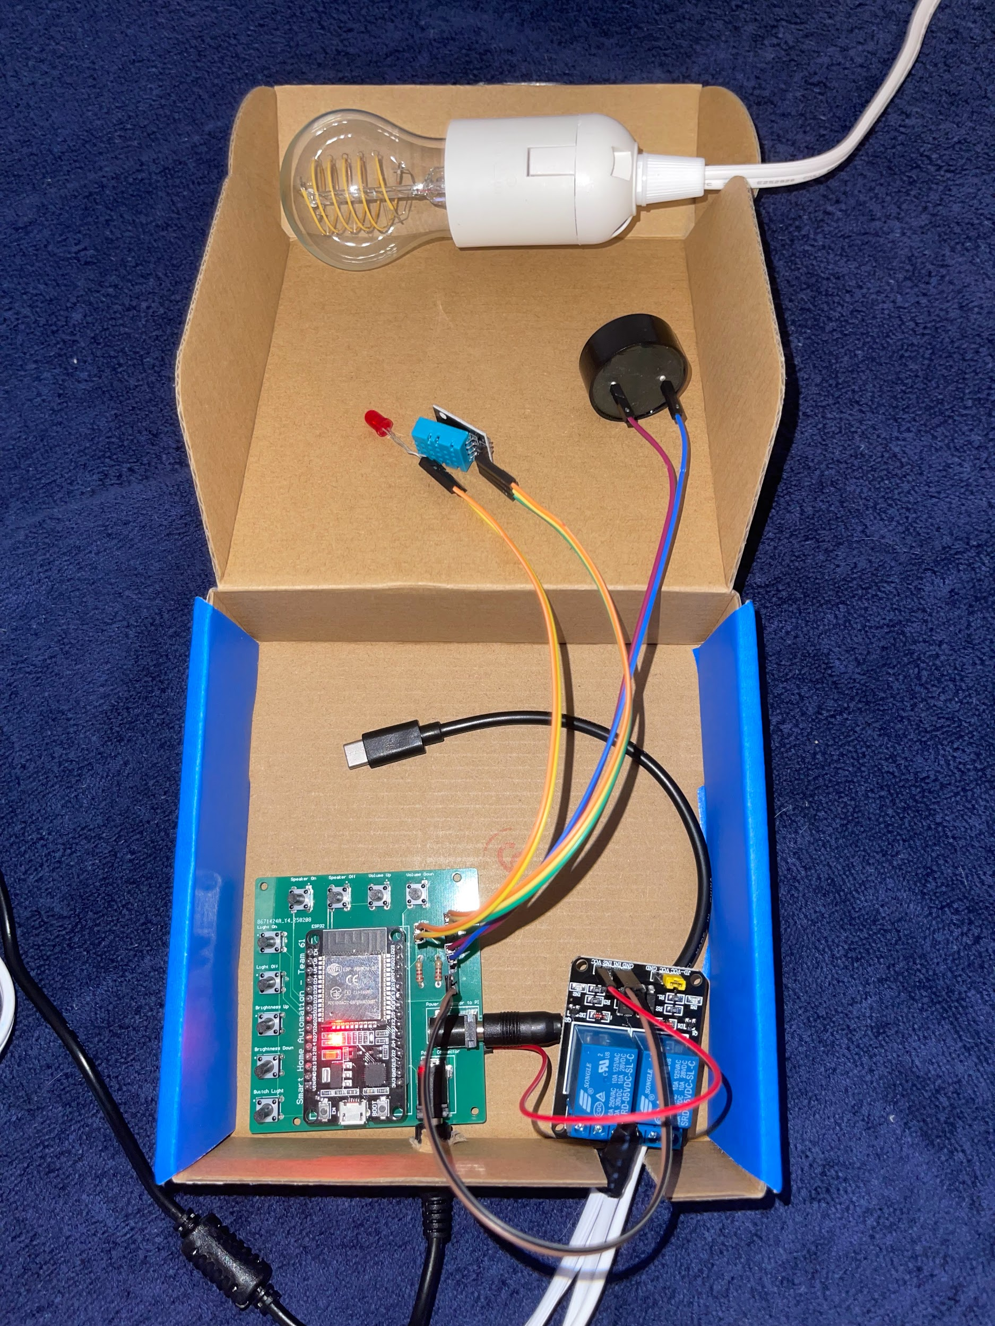
Integrated System Diagram
IoT Hardware and Raspberry PI communicate using MQTT
Conceptual Design
Notes:
Eric

Slide 4
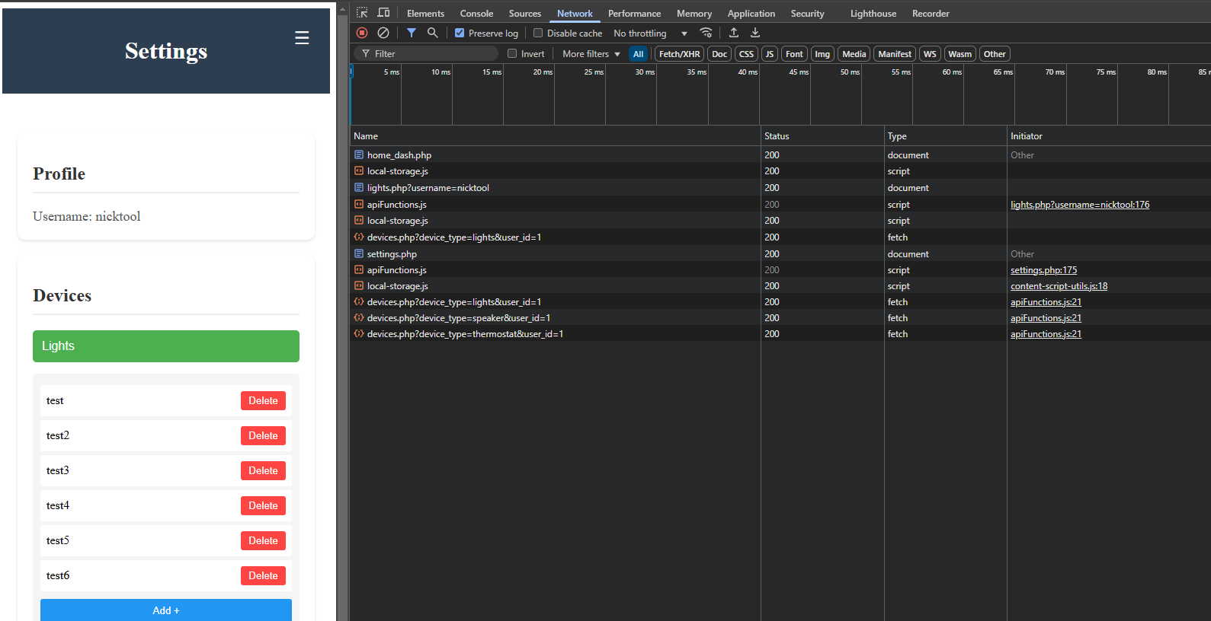
Integrated System Diagram
Notes:
Eric

Slide 5
Project Timeline
Green done, Yellow underway, White not started
Subsystem Designs and Testing (to complete 2/10) | Integration of App and Website (to complete 2/24) | Integration of IoT Hardware (to complete by 3/10) | Final Integration (to complete by 3/17) | System Test (to complete by 3/24) | Validation (to complete by 4/7) | Demo and Report (to complete by 4/21)
Notes:
Eric

Slide 6
Hardware Integration
Tyler Mayou
Accomplishments since last update 20 hrs of effort | Ongoing progress/problems and plans until the next presentation
Hardware board powers Raspberry PI and all connected devices Changes to subsystem | SW integration for ESP32 with Back-end using MQTT Validation of communication and control of devices

Slide 7
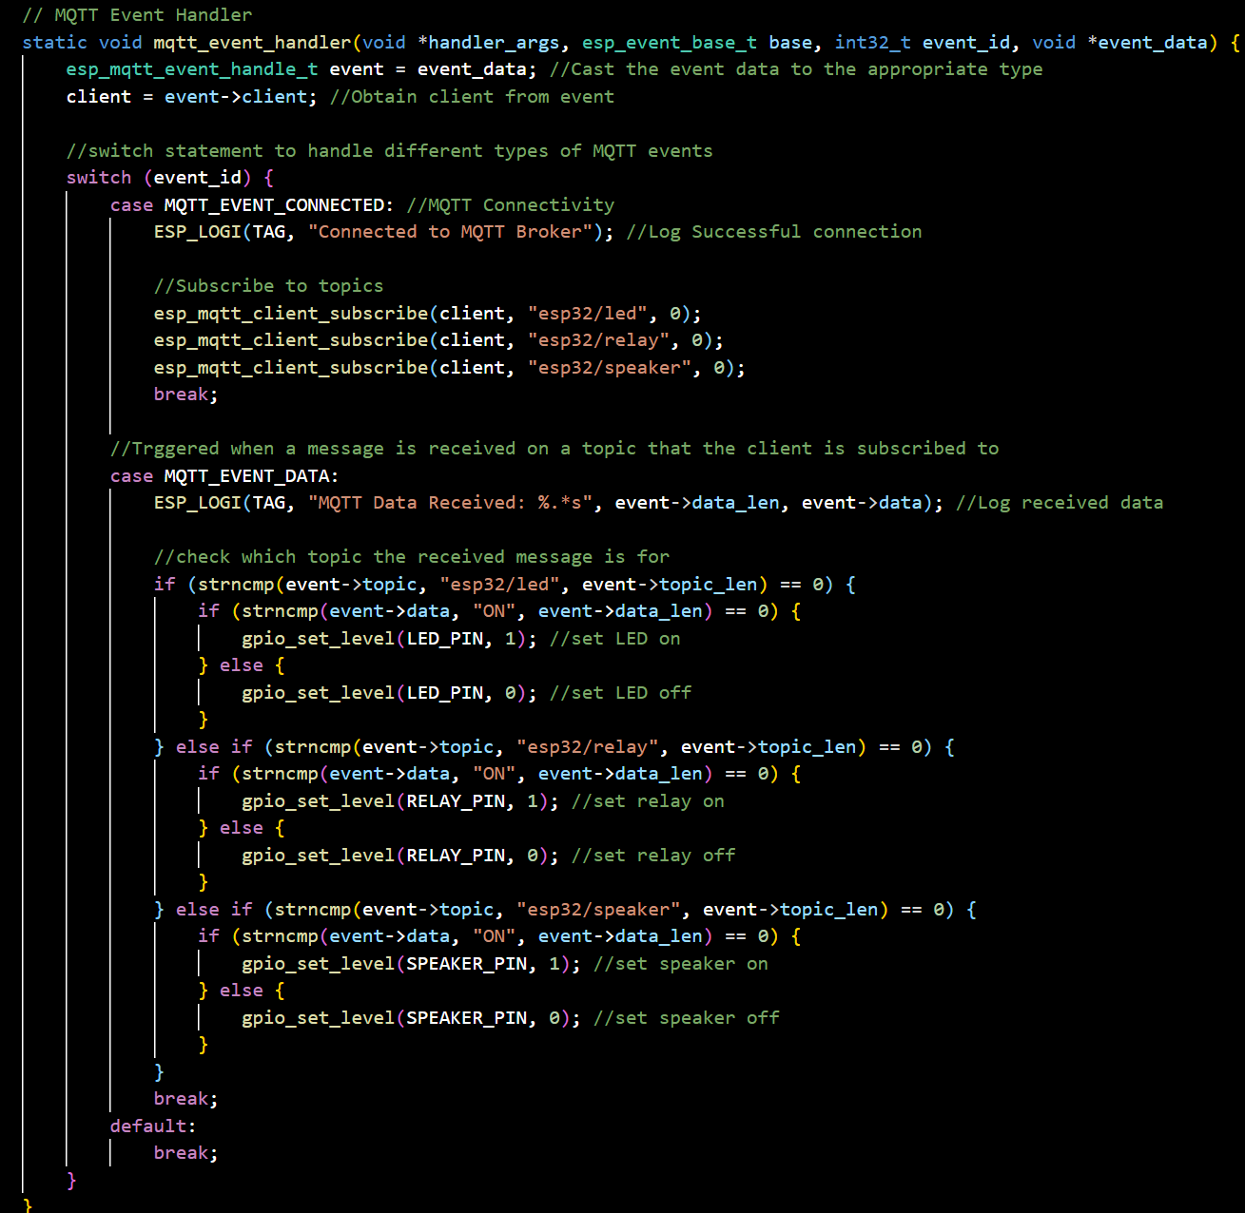
Hardware Integration

Slide 8
Web and Mobile App
Matthew McLean
Accomplishments since last update 18 hours of effort | Ongoing progress/problems and plans until the next presentation
Frontend and Backend Integration is nearly complete Progress will be shown with backend slides | Finish integrating mobile app with web app

Slide 9
Back-End Development
Nicholas Tool
Accomplishments since last update 25 hrs of effort | Ongoing progress/problems and plans until the next presentation
Full Integration of Current Website and Backend Logic Verified database entries are as expected when using webpage (users and devices) | Integration with ESP32 using MQTT Error handling on webpage, edge case testing Full system testing of functionality

Slide 10
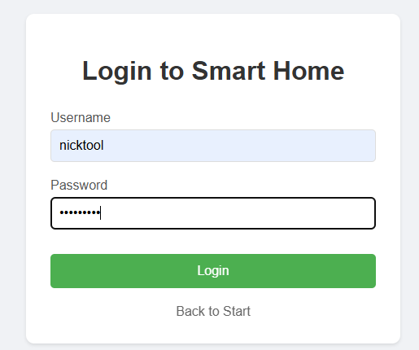
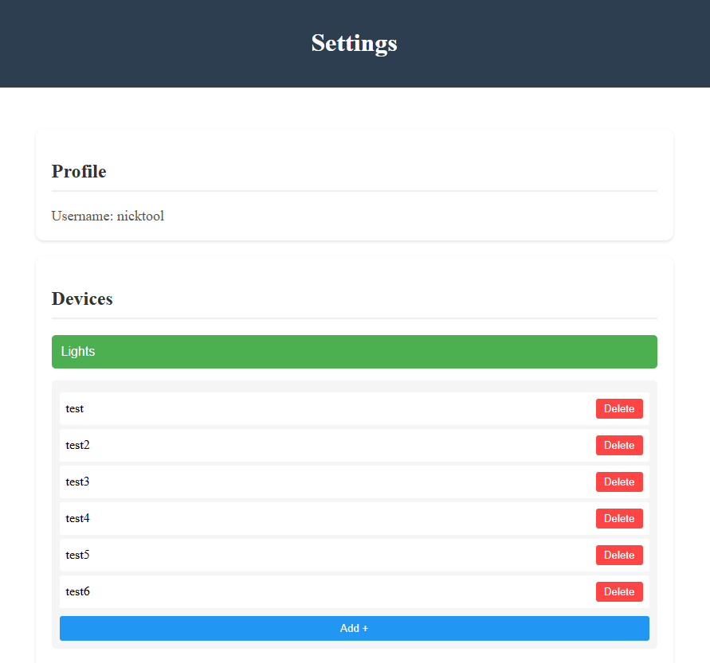
Back End Development

Slide 11
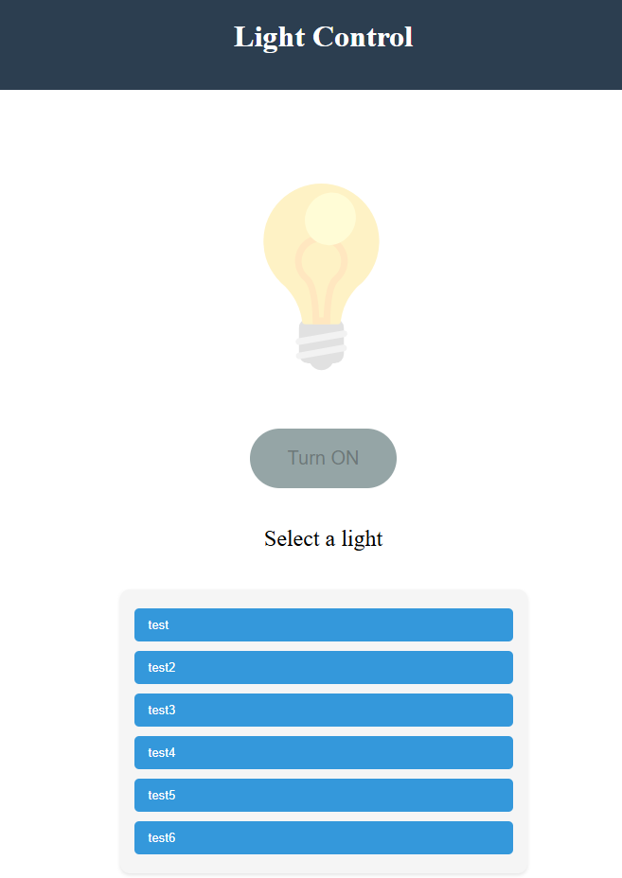

Slide 12
Execution Plan
 | 1/20 | 1/27 | 2/3 | 2/10 | 2/17 | 2/24 | 3/3 | 3/10 | 3/17 | 3/24 | 3/31 | 4/7 | 4/14 | 4/21 | 4/28 | Legend
Matthew McLean |  |  |  |  |  |  |  |  |  |  |  |  |  |  |  | Finished
Update Layout Of Website |  |  |  |  |  |  |  |  |  |  |  |  |  |  |  | Working on it
Integrate System with Host Server |  |  |  |  |  |  |  |  |  |  |  |  |  |  |  | Haven’t Started
Integrate Entire System
Nick Tool
Implement Public IP address
Implement Security Features
Integrate Host System with Mobile App and Website
Integrate Host System with IoT Hardware
Validate App & Website Integration
Validate IoT Hardware Integration
Test and Validate Basic Functions in Fully Integrated System
Test Edge Cases in Fully Integrated System
Tyler Mayou
Discuss 404 modifications
Order parts for modification
Order NEW PCB
Hardware integration
Team
Update #2
Update #3
Update #4
Update #5
Final Presentation
Final Demo
Final Report
Integration
System Test
Validation
Notes:
Michelle

Slide 13
SYSTEM Validation Plan
Test Name | Success Criteria | Methodology | Status | Owner
Power to hardware and Raspberry PI | Hardware board/components and Raspberry PI are powered at rated limits (PI - 5V 5A, Hardware - 5V 1A). PI is hosting server. All components through ESP32 are functional. | Plug in all components, Check if PI is hosting website, check if device components are functional. | TESTED | Tyler Mayou, Nick Tool
Communication between Raspberry PI and ESP32 | Both Raspberry PI and ESP32 can send and receive data through MQTT communication (Button presses from either side, Sensor Data). | First Establish connection between Raspberry PI and ESP32. Test if button presses are sent and received both ways. Test if sensor data can be sent/received. Lights/speaker are controllable from button press. | UNTESTED | Tyler Mayou, Nick Tool
Sign Up Functionality | User can create a new unique user in system and database reflects parameters. | Try to create a new user from the public website, check the database to make sure information matches sign up. | TESTED | Nick Tool, Matthew Mclean
Login Functionality | User can login to system, user stays logged in when navigating to different pages. | User will log in using created credentials, navigate to different pages, including settings, where the correct username should appear. | TESTED | Nick Tool, Matthew Mclean
Add and Delete Devices | User can add new devices to the system and delete devices from the system, while database reflects these changes. | On the settings page, add a new device while being logged in, check database to make sure that new device was added. | TESTED | Nick Tool, Matthew Mclean
Toggle Specific Device Status | User can select a specific device, and update its status or a specific parameter (Brightness, Volume, Temperature) | On any of the device pages, user will select a specific device, make a change to its status, and changes show up in the database | PARTIALLY TESTED | Nick Tool, Matthew Mclean
Notes:
Michelle

Slide 14
Thanks and Gig’ Em!

